Slide 1
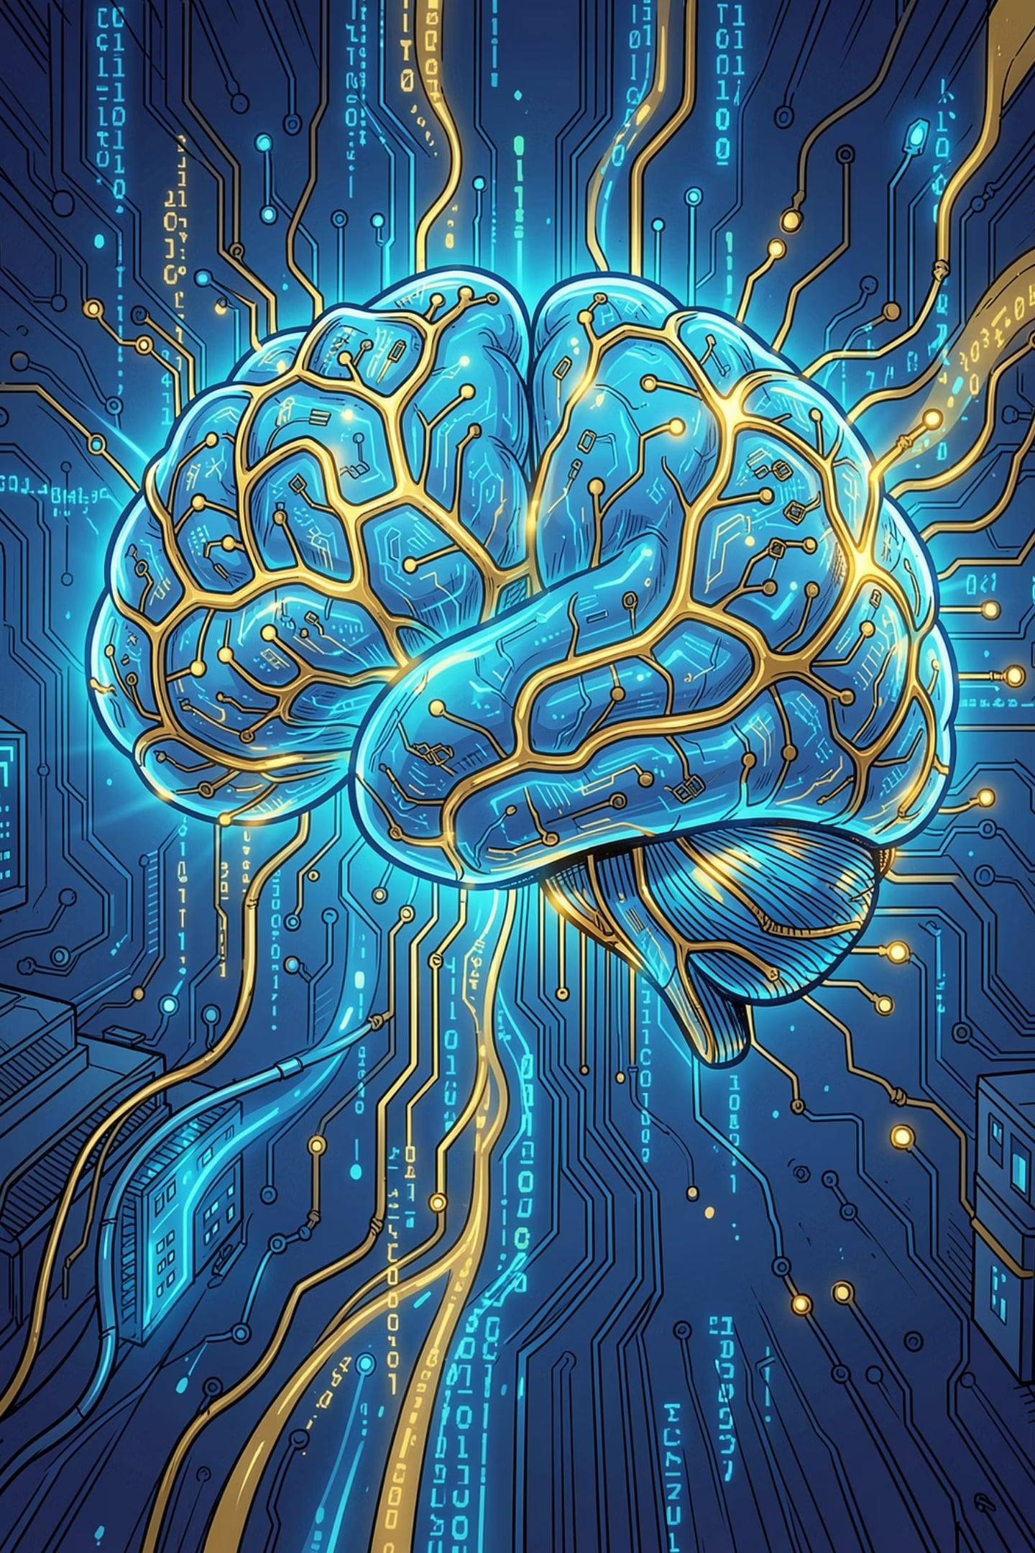
Introduction to Artificial Intelligence
A comprehensive overview of AI's structure, history, definitions, approaches, and current capabilities — from philosophical foundations to modern intelligent systems.
AI FUNDAMENTALS
COMPUTER SCIENCE

Slide 2
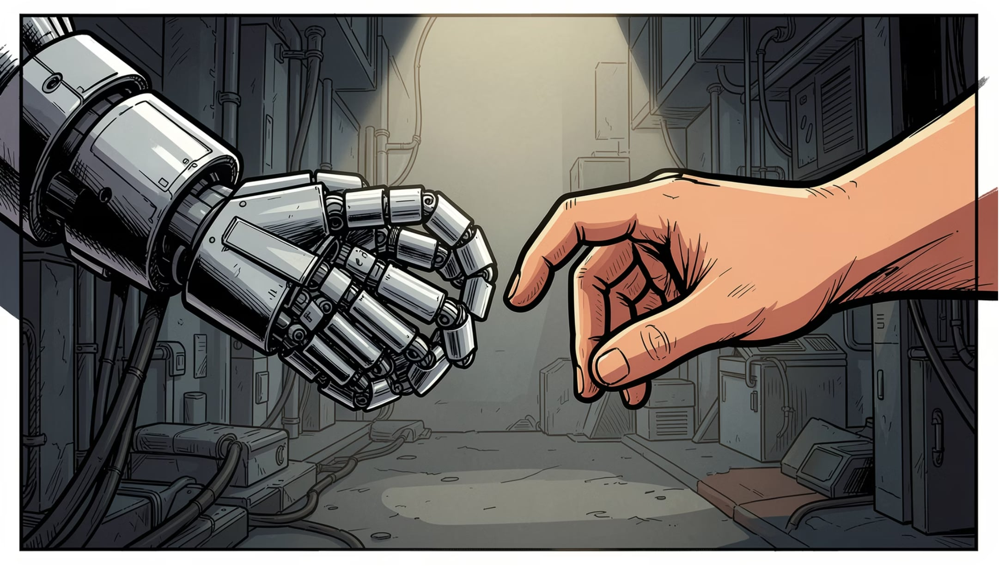
What Is AI?

Slide 3
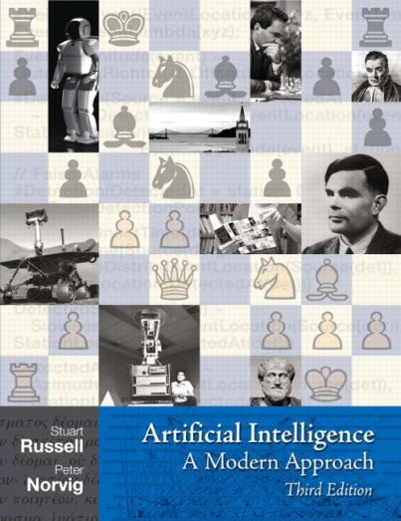
Textbooks
  **** Russell & Norvig, AI: A Modern Approach, 3rd Edition
  Artificial Intelligence, Kevin Knight, Elaine Rich, B. Shivashankar Nair, 2nd Edition,
  2008
  Artificial Neural Networks, B. Yagna Narayana, PH

Slide 4
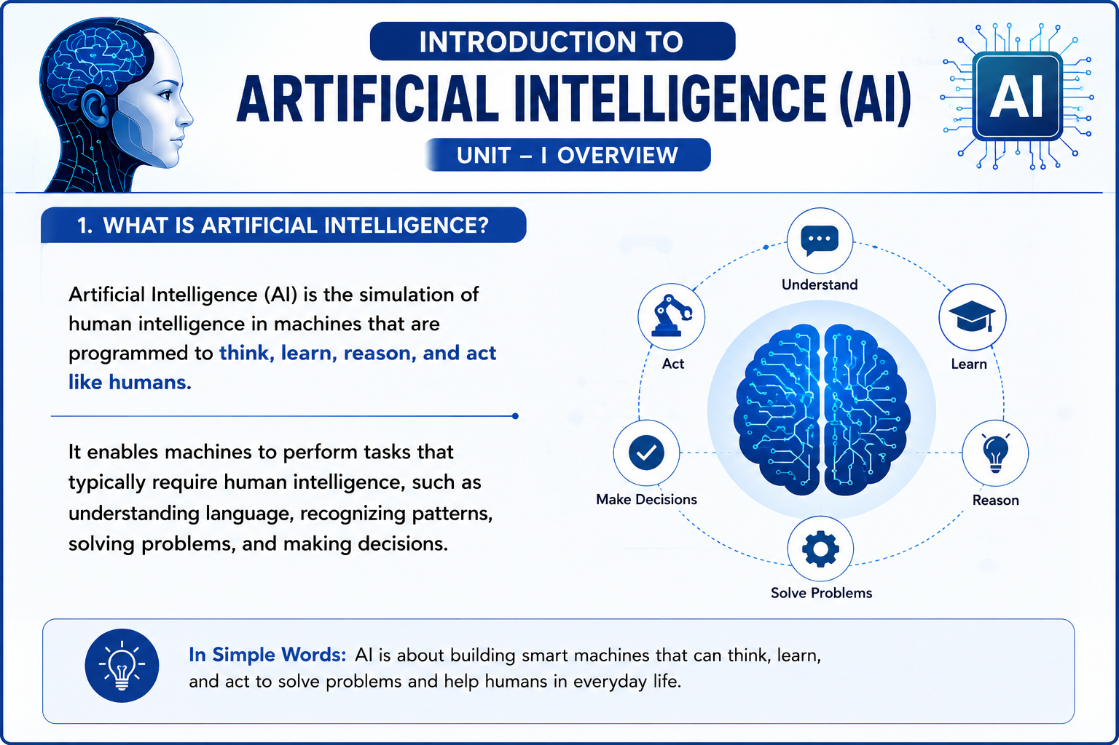

Slide 5
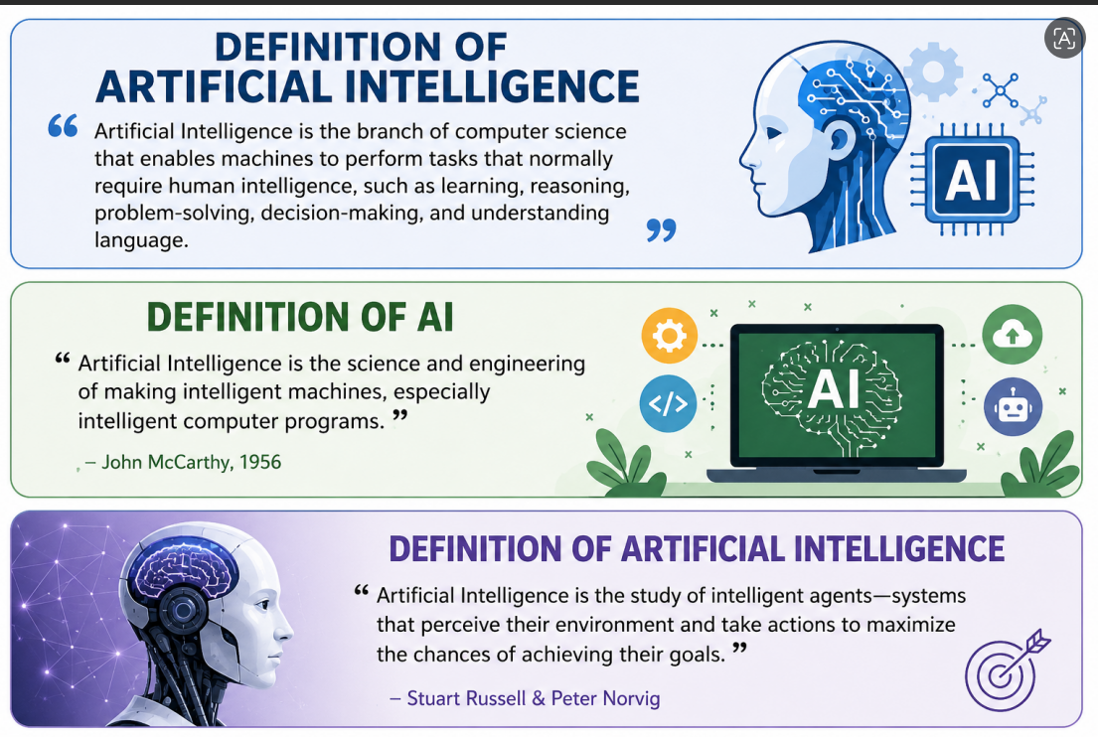

Slide 6
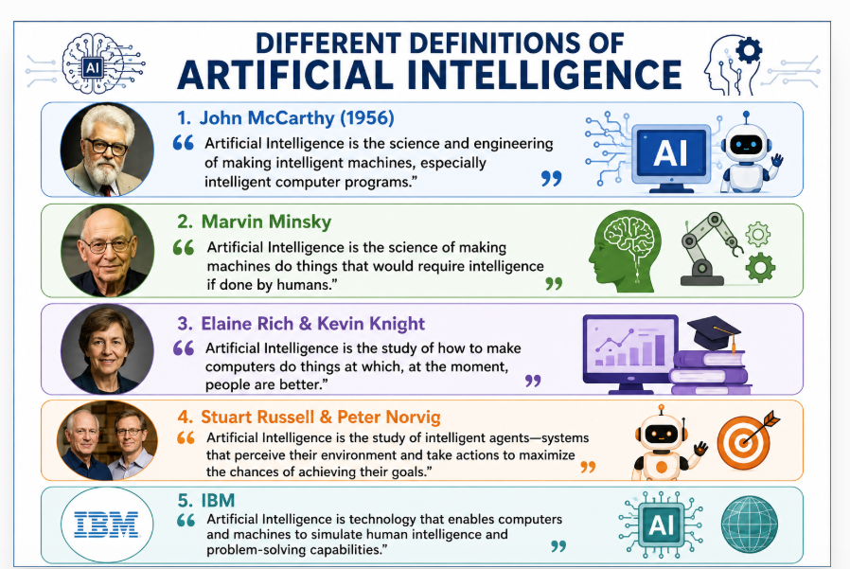

Slide 7











Defining Artificial Intelligence
Scholars have offered many definitions of AI over the decades. Collectively, they reveal four fundamental perspectives on what it means for a system to be "intelligent."
"The branch of computer science that is concerned with the automation of intelligent behavior." — Luger and Stubblefield, 1993
"The study of the computations that make it possible to perceive, reason, and act." — Winston, 1992
"The art of creating machines that perform functions that require intelligence when performed by people." — Kurzweil, 1990
"The study of how to make computers do things at which, at the moment, people are better." — Rich and Knight, 1991
"A field of study that seeks to explain and emulate intelligent behavior in terms of computational processes." — Schalkoff, 1990
"The exciting new effort to make computers think — machines with minds, in the full and literal sense." — Haugeland, 1985
These definitions lead to four possible conclusions about AI: systems that think like humans, systems that think rationally, systems that act like humans, and systems that act rationally. The textbook advocates "acting rationally" as the most productive framework.

Slide 8
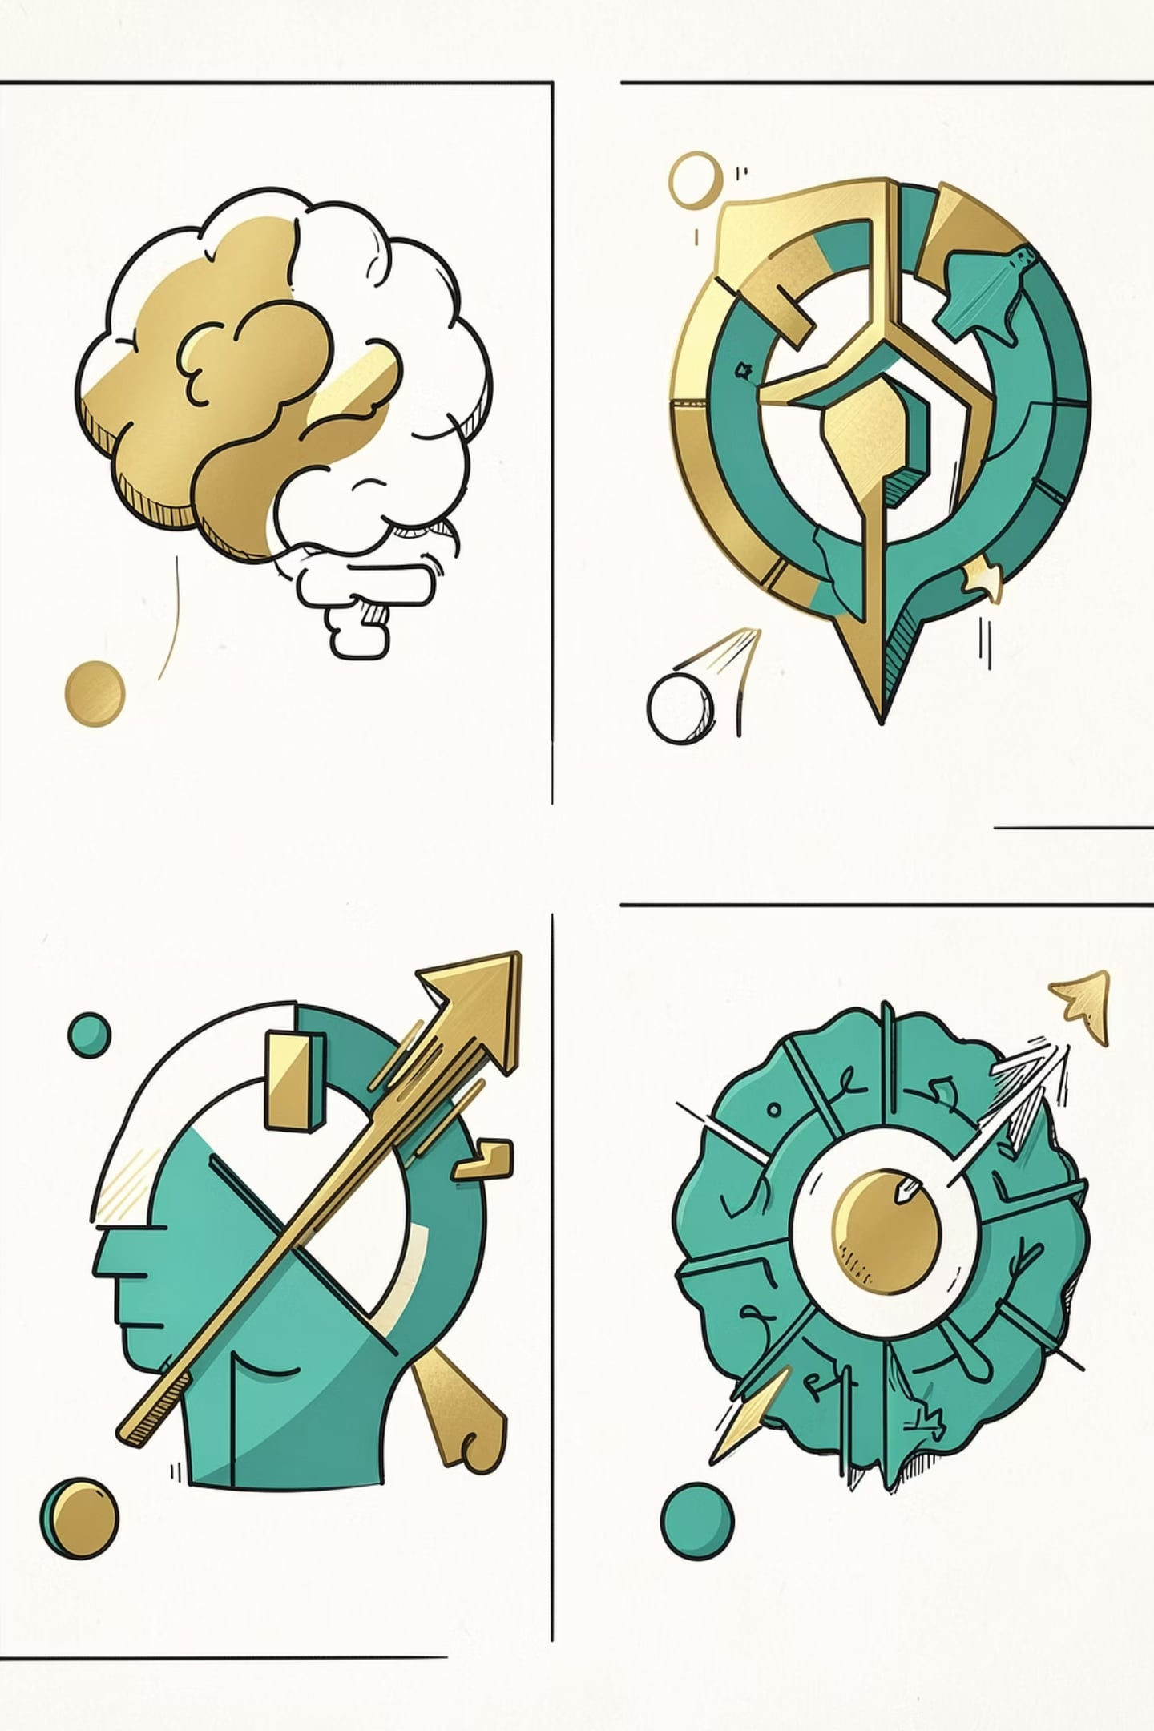
Four Approaches to AI
Think Like Humans
Cognitive modeling of brain processes
Think Rationally
Laws of logic and correct reasoning
Act Like Humans
Turing Test — imitation game
Act Rationally
Maximize goal achievement — textbook's preferred approach

Slide 9




Four Approaches to Defining AI
Think Like Humans
Think Rationally
Cognitive modeling — requires scientific theories of internal brain activity. Validation via behavioral prediction or neurological data. Now distinct from AI.
"Laws of thought" — Aristotle's logic, formal derivation. Problem: not all intelligent behavior is logical deliberation.
Act Like Humans
Act Rationally
Turing Test (1950) — imitation game. Requires knowledge, reasoning, language understanding, and learning. Still relevant today.
Rational agent: does the right thing — maximizing goal achievement given available information. Textbook advocates this approach.

Slide 10
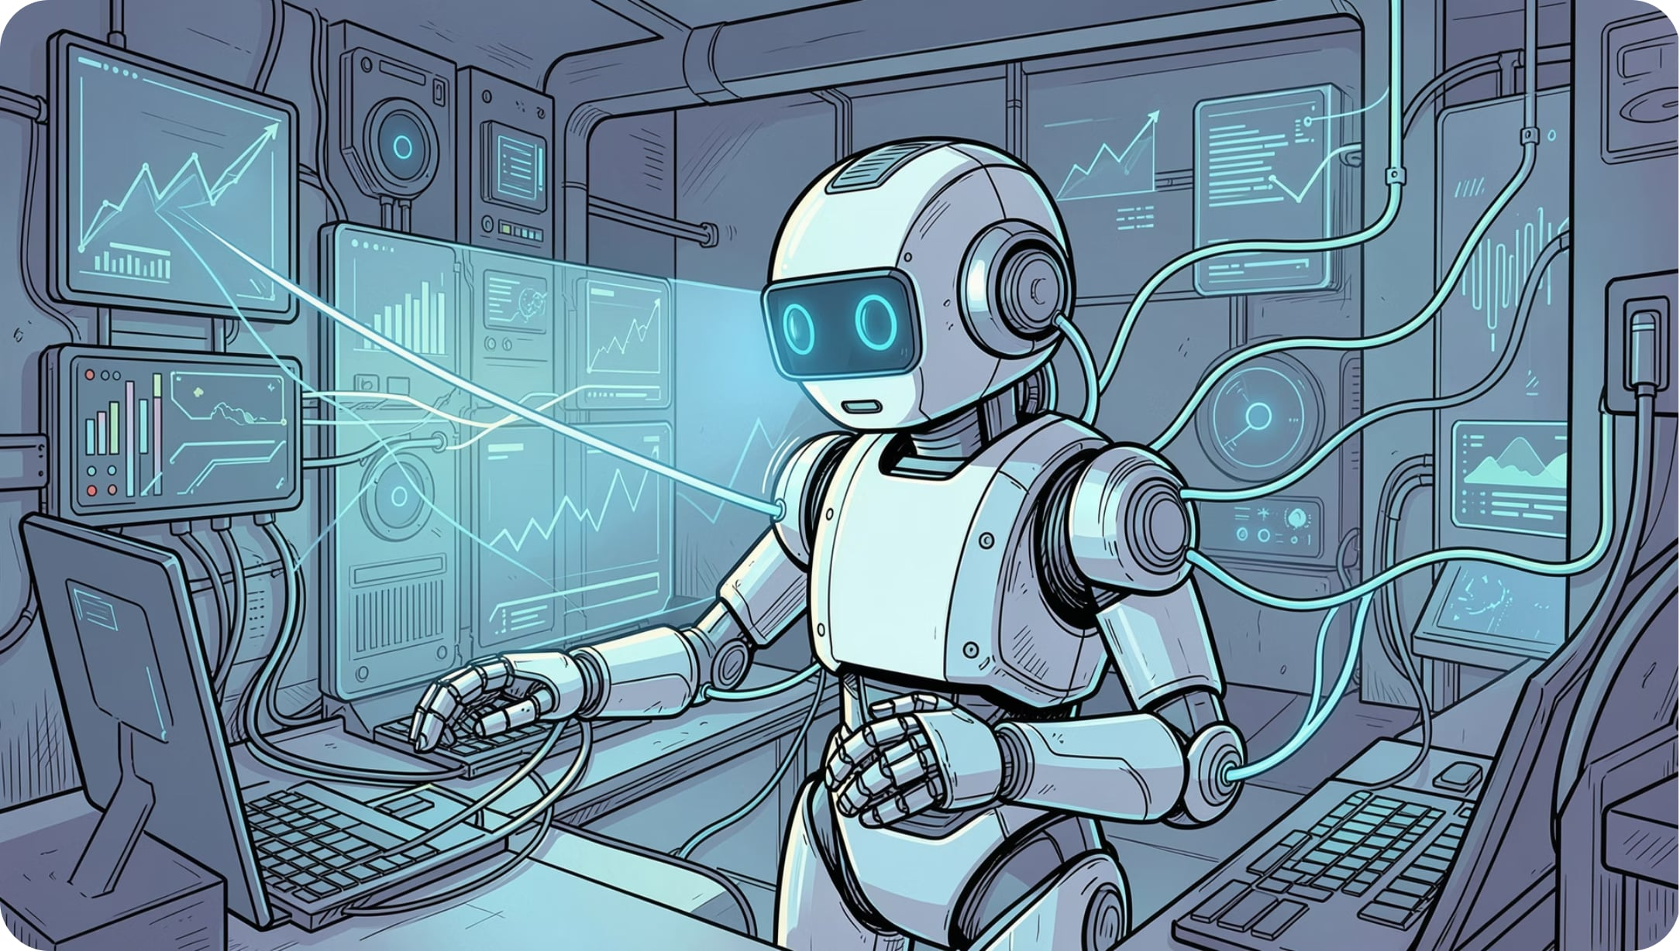
Rational Agents & Key Challenges
Rational Agent
An agent perceives and acts. Abstractly, a function from percept histories to actions:
We seek the agent with best performance for a given environment. Computational limits make perfect rationality unachievable.
Big Obstacles
Brain knowledge gap — too little understanding of how context is inferred
Prior knowledge — machines need environmental knowledge to match human behavior
Brain models may be counter-productive — attack problems given the nature of digital computers

Slide 11
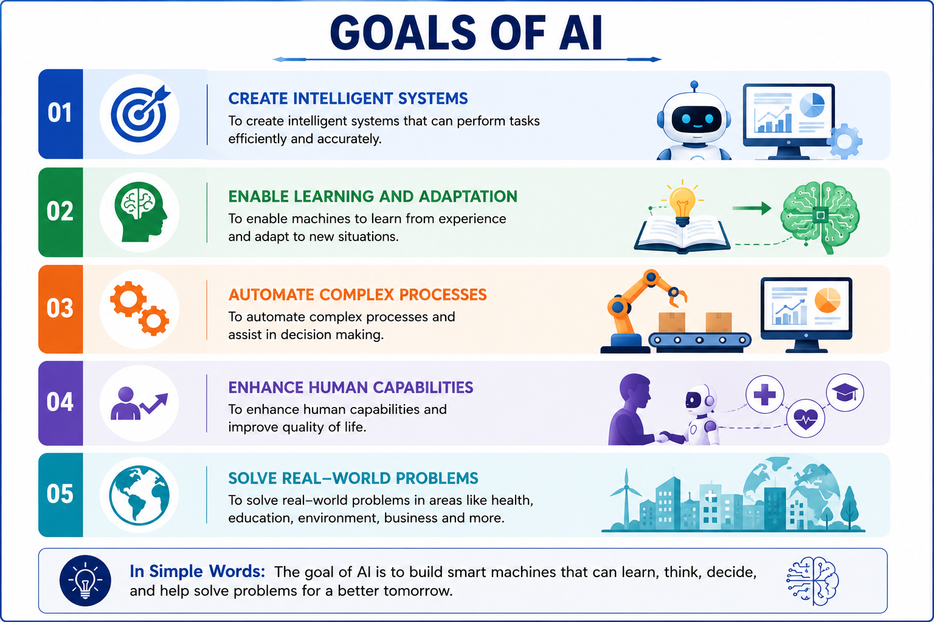

Slide 12
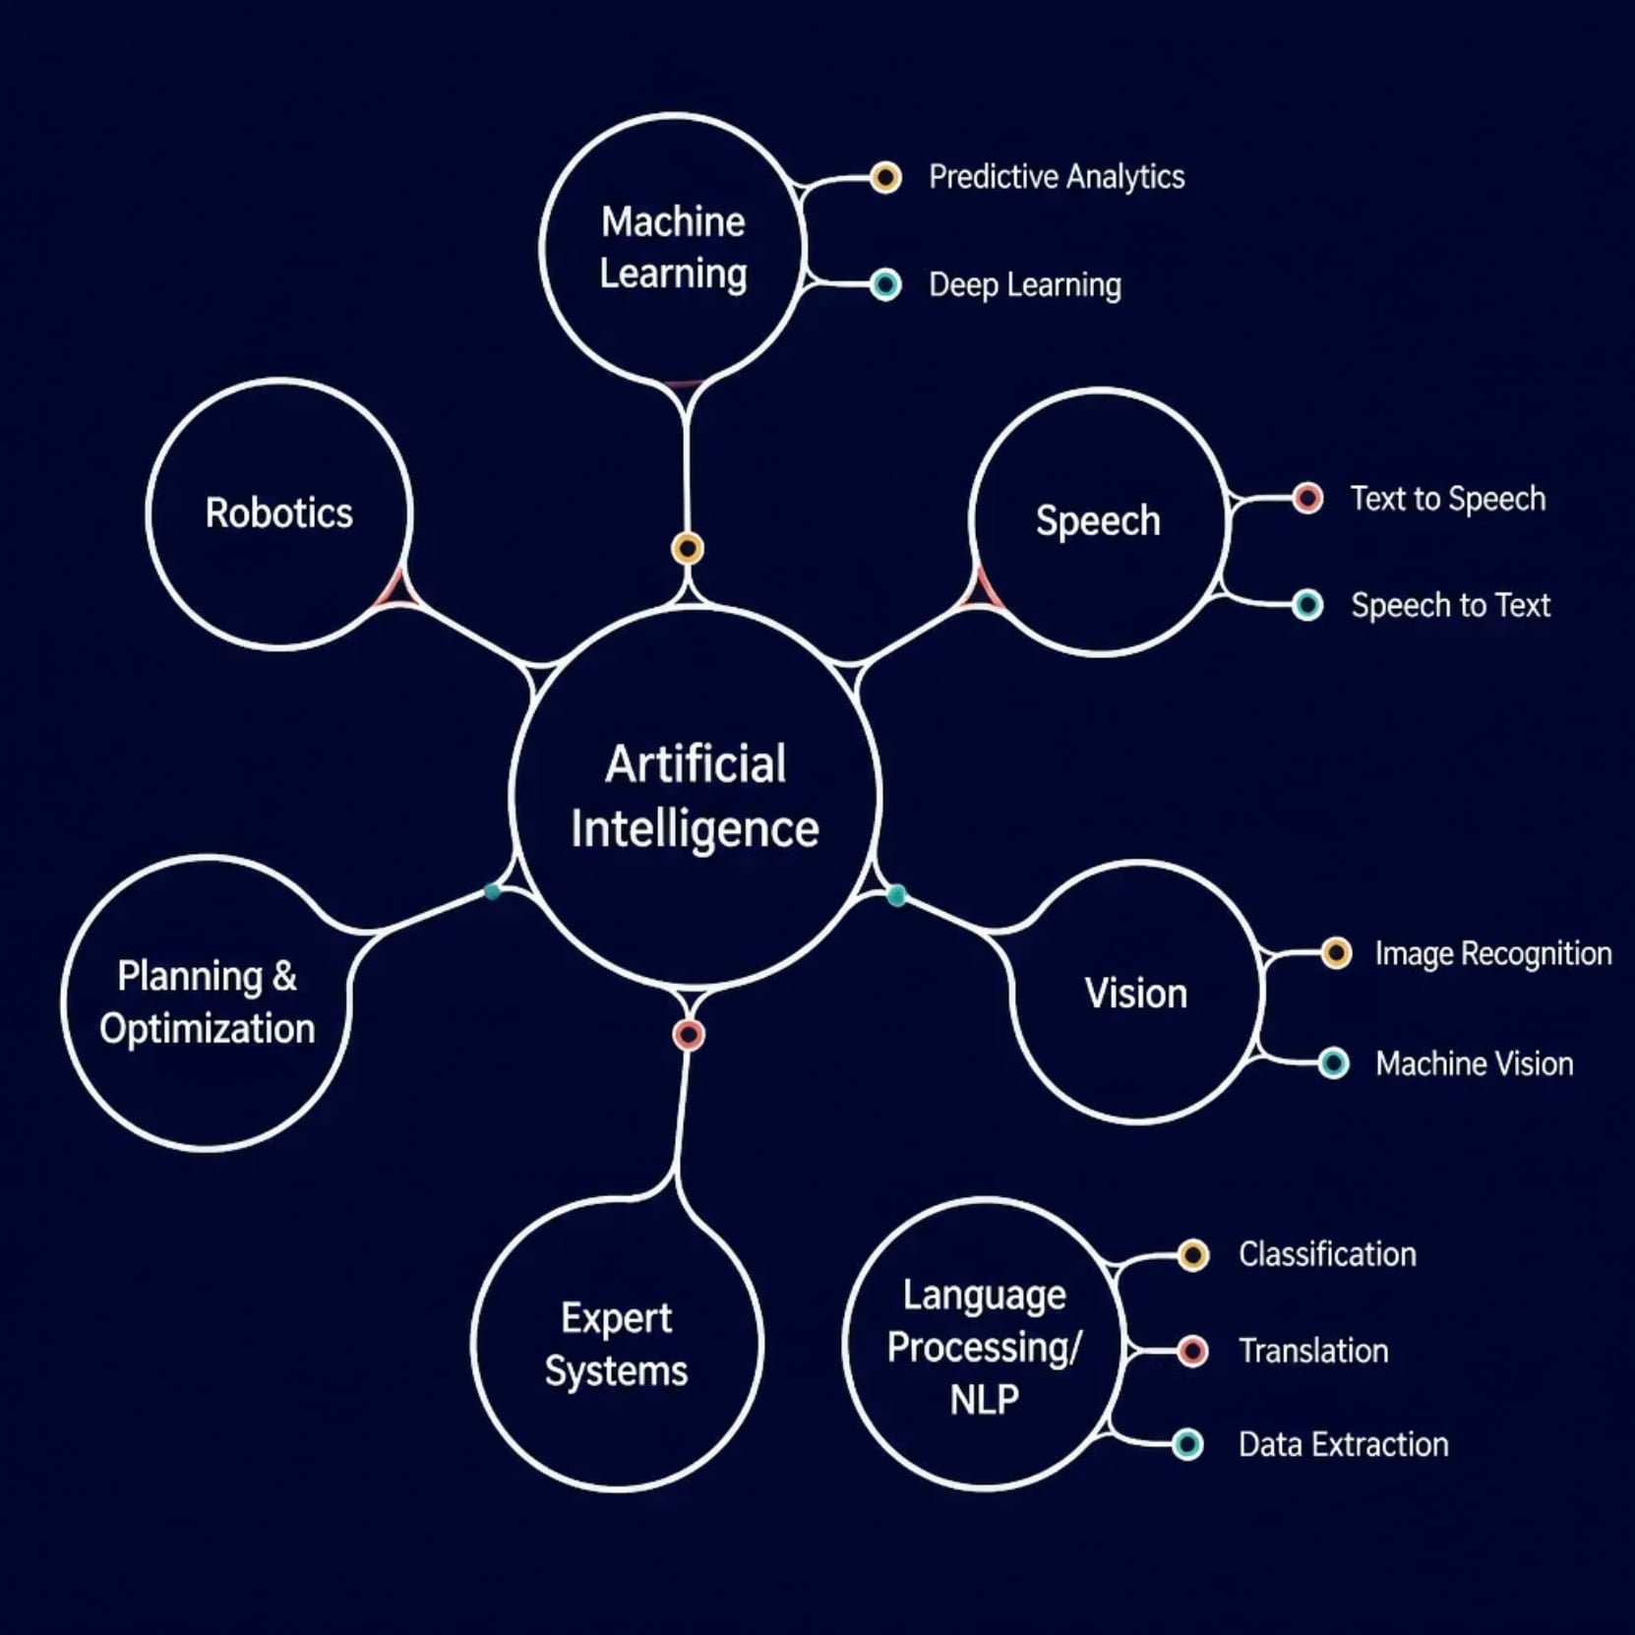
AI Branches at a Glance
Seven Core Domains
AI spans seven major fields — from Machine Learning and NLP to Robotics and Vision — each with specialized sub-fields driving real-world applications.

Slide 13







Structure of Artificial Intelligence
Artificial Intelligence encompasses a broad family of subfields, each addressing a different aspect of intelligent behavior. At its core, AI branches into seven major domains, many of which contain specialized sub-techniques.
Machine Learning
Speech
Vision
Predictive Analytics
Deep Learning
Text to Speech
Speech to Text
Image Recognition
Machine Vision
NLP
Expert Systems
Planning & Optimization
Classification
Translation
Data Extraction
Knowledge-based reasoning systems
Goal-directed decision making
Robotics
Physical intelligent agents
These domains collectively define the landscape of AI research and application, from perceiving the world (vision, speech) to reasoning about it (planning, expert systems) and acting within it (robotics).

Slide 14
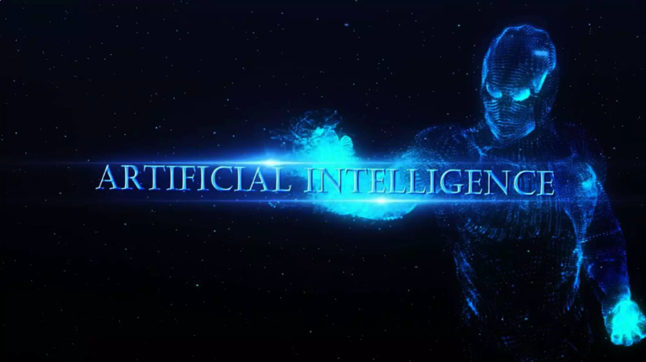

Slide 15


Slide 16
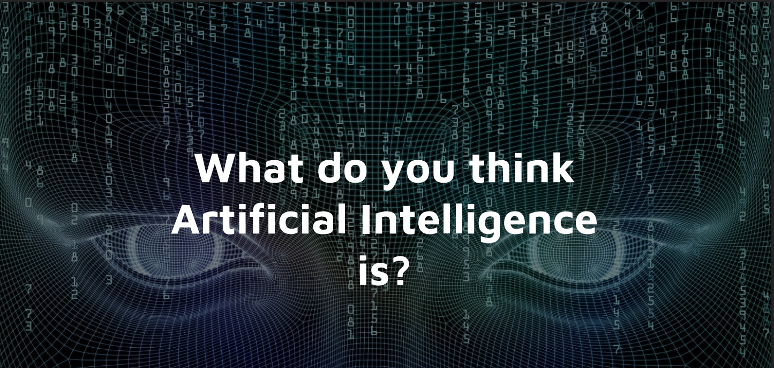

Slide 17
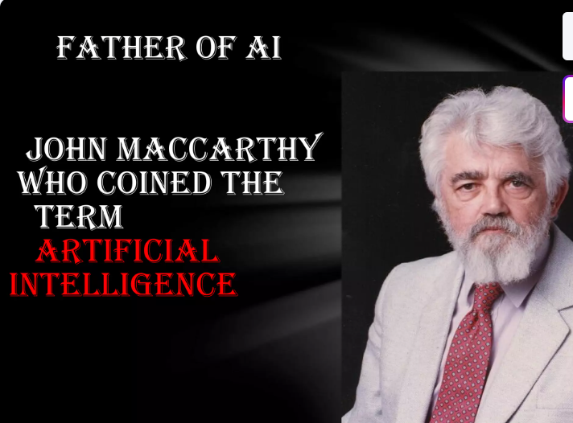

Slide 18
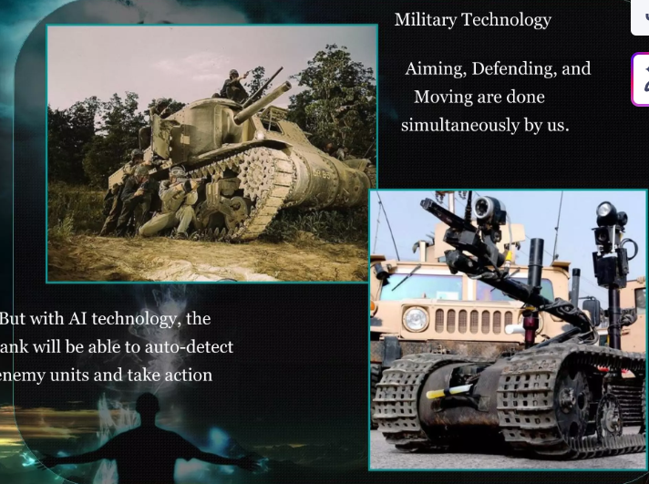

Slide 19
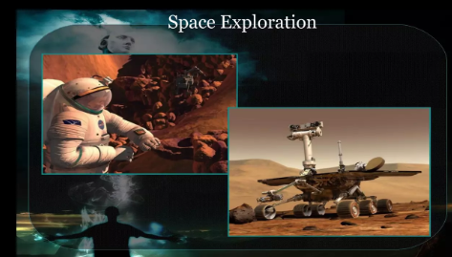
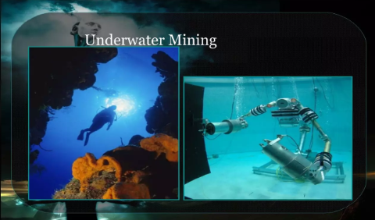

Slide 20
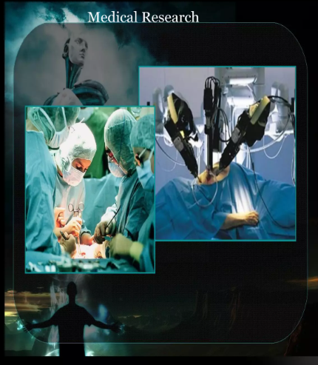

Slide 21
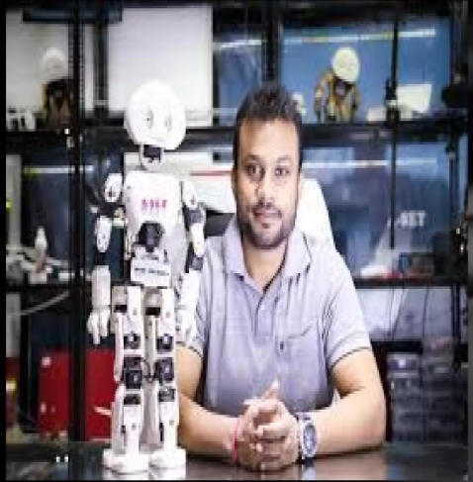
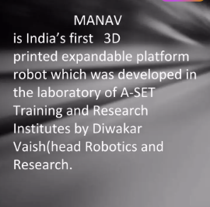

Slide 22
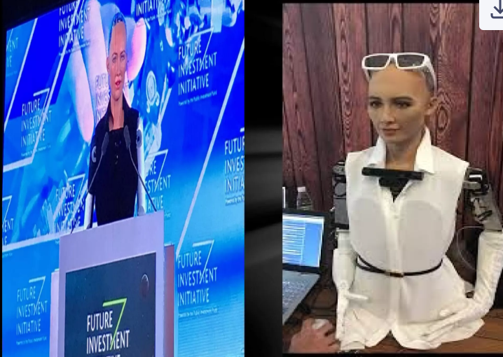


Slide 23
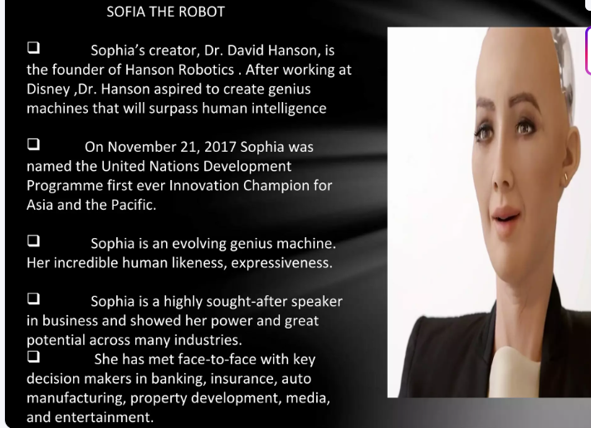

Slide 24
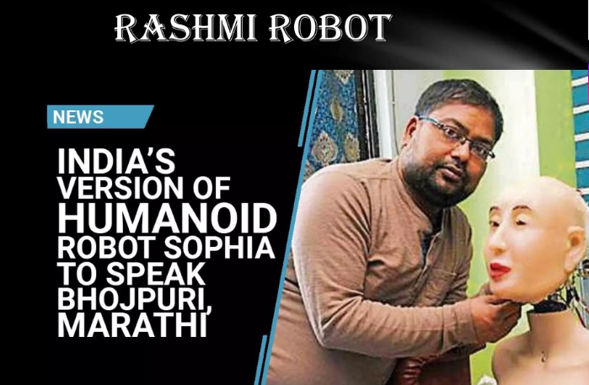

Slide 25
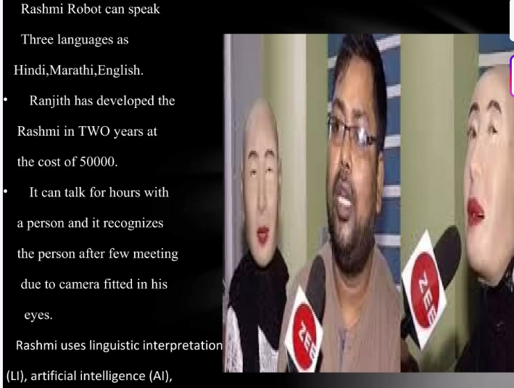

Slide 26
Introduction to Intelligence Vs AI
INTELLIGENCE | ARTIFICIAL INTELLIGENCE
It is a natural process. | It is programmed by humans.
It is actually hereditary. | It is not hereditary.
Knowledge is required for intelligence. | KB and electricity are required to generate output.
No human is an expert. We may get better solutions from other humans. | Expert systems are made which aggregate many persons’ experience and ideas.

Slide 27
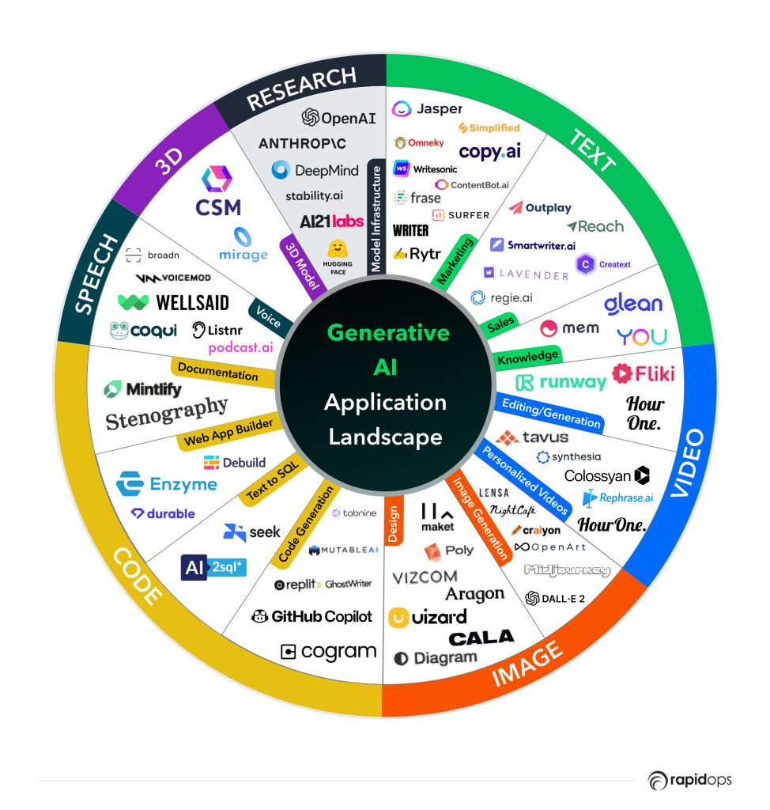
This is how AI is being used currently

Slide 28
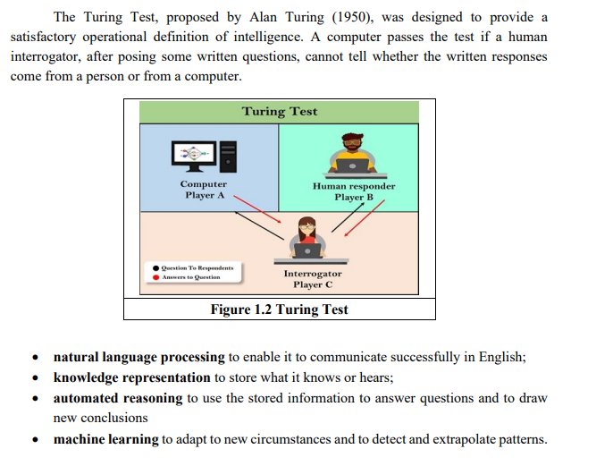
Turing Approach/Acting Humanly

Slide 29
Foundations of AI
Mathematics
Philosophy
Linguistics
Economics
Neuroscience
Psychology
Computer Engineering
Control Theory and Cybernetics

Slide 30
Philosophy(428 B.C to present)
How knowledge has come?
What is knowledge?

Slide 31
Through observation
Through Confirmation
Through use of awareness
Through inducing and all etc.,…
Dualism(Body &Soul)
Materialism(body)

Slide 32
Mathematics(C.800 –present)
Through axioms/rules
Through algorithms
Through proofs
Probability and Random functions
What are the formal rules/conclusions?
What is logic
How is it being proved
What are instances..
How do we prove.. Etc.,

Slide 33
Economics(1776 –present)
How should we make decisions?
What is future rate of growth?
Through Decision theory
Games
Operations research
Survey
General awareness

Slide 34
Neuroscience(1861 –present)
How do brains process information?
How do they/we remember?
How is information stored?
How is information retained?
Through Neuroscience
Through cognition
Through neurons
Through sensors
Through synapses

Slide 35
Psychology(1879-present)
How do humans and animals think and learn?
How do they act?
How do they respond?
Through Behaviorism
Through sensors/Snesing
Through cognitive psychology
Through perceiving

Slide 36
Computer Engineering (1940 –present)
How can we build an efficient computer?
Through programming
Through logic functions
Through iterations
Through knowledge setup
Build an efficient computer (HW/SW)

Slide 37
Control Theory and Cybernetics(1948-Present)
How can artifacts operate under their own control?
Through security
Through objective function
Through control theory

Slide 38
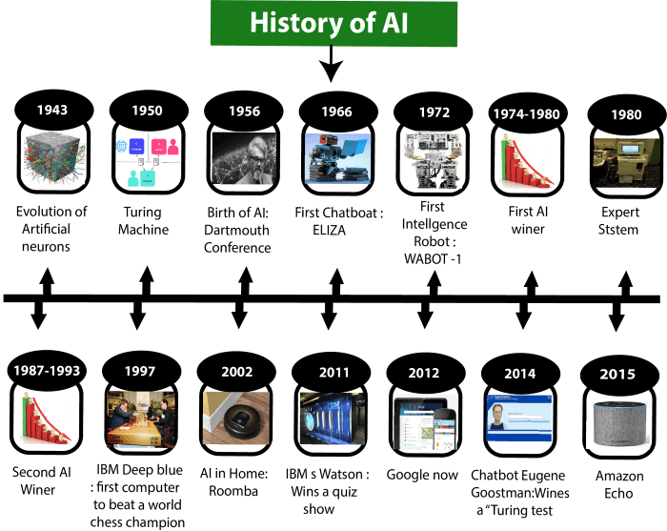
History of AI
journey from the AI generation to till date development.

Slide 39
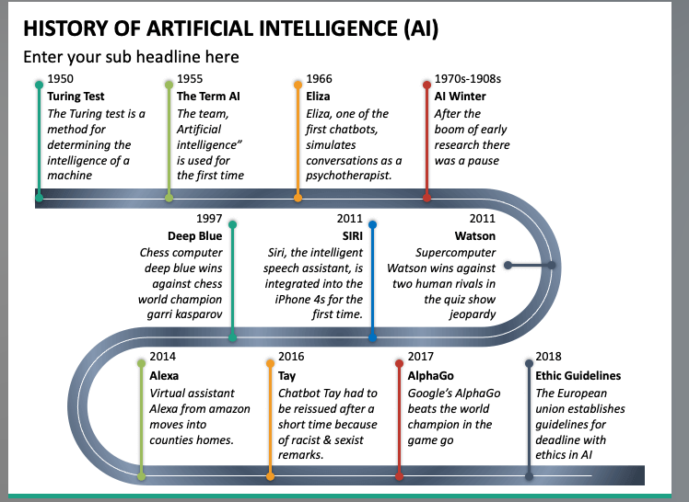
In general, And would find in most of the search results

Slide 40
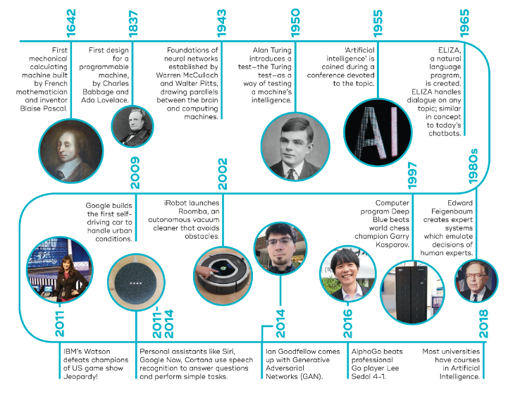
History of AI :Different timelines, Different Researchers

Slide 41
History of AI
The emergence of intelligent agents (1993-2011)
Year 1997: In the year 1997, IBM Deep Blue beats world chess champion, Gary Kasparov, and became the first computer to beat a world chess champion.
Year 2002: for the first time, AI entered the home in the form of Roomba, a vacuum cleaner.
Year 2006: AI came in the Business world till the year 2006. Companies like Facebook, Twitter, and Netflix also started using AI.

Slide 42
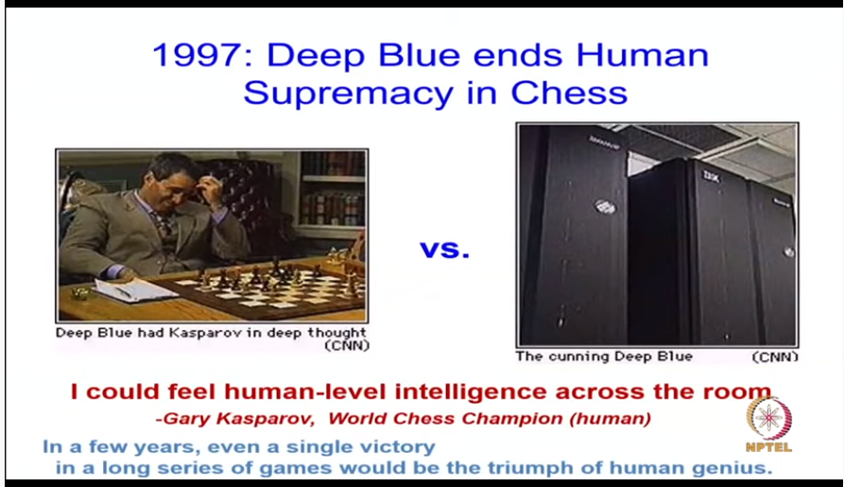

Slide 43
State of Art of AI: Currently
Autonomous Planning and scheduling
Game Playing
Autonomous control
Diagnosis
Logistic Planning
Robotics
Language understanding and Problem solving
Recommendations
Predictions and many more…Now AI is a part of Ecosystem in itself…..

Slide 44
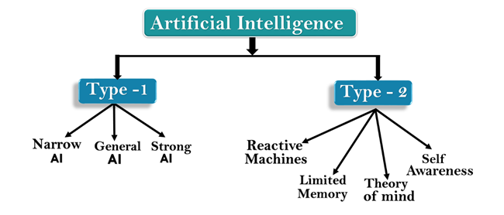
Types of Artificial Intelligence:

Slide 45
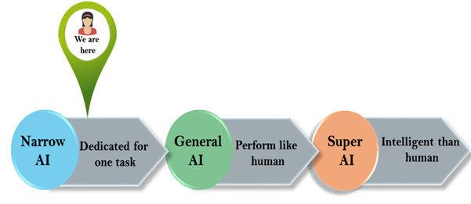
Types of Artificial Intelligence

Slide 46
Weak AI or Narrow AI:
Narrow AI perform a dedicated task with intelligence. Currently available AI is Narrow AI.
Narrow AI cannot perform beyond its field or limitations, as it is only trained for one specific task. Hence it is also termed as weak AI.
Apple Siri is a good example of Narrow AI.
IBM's Watson supercomputer also comes under Narrow AI, as it uses an Expert system approach combined with Machine learning and natural language processing.
Some Examples of Narrow AI are playing chess, purchasing suggestions on e-commerce site, self-driving cars, speech recognition, and image recognition.

Slide 47
General AI:
General AI is a type of intelligence which could perform any intellectual task with efficiency like a human.
The idea behind the general AI to make such a system which could be smarter and think like a human by its own.
Currently, there is no such system exist which could come under general AI and can perform any task as perfect as a human.

Slide 48
Super AI:
Super AI :machines could surpass human intelligence, and can perform any task better than human with cognitive properties.
Machine can have ability to think, to reason , solve the puzzle, make judgments, plan, learn, and communicate by its own.
Super AI is still a hypothetical concept of Artificial Intelligence.
Development of such systems in real is still world changing task.

Slide 49
Artificial Intelligence type-2: Based on functionality
1. Reactive Machines
Such AI systems do not store memories or past experiences for future actions.
These machines only focus on current scenarios and react on it as per possible best action.
IBM's Deep Blue system is an example of reactive machines.
Google's AlphaGo is also an example of reactive machines.

Slide 50
Artificial Intelligence type-2: Based on functionality
2. Limited Memory
Limited memory machines can store past experiences or some data for a short period of time.
These machines can use stored data for a limited time period only.
Self-driving cars are one of the best examples of Limited Memory systems. These cars can store recent speed of nearby cars, the distance of other cars, speed limit, and other information to navigate the road.

Slide 51
Artificial Intelligence type-2: Based on functionality
3. Theory of Mind
Theory of Mind AI should understand the human emotions, people beliefs, and be able to interact socially like humans.
This type of AI machines are still not developed, but researchers are making lots of efforts and improvement for developing such AI machines.

Slide 52
Artificial Intelligence type-2: Based on functionality
4. Self-Awareness
Self-awareness AI is the future of Artificial Intelligence. These machines will be super intelligent, and will have their own consciousness, sentiments, and self-awareness.
These machines will be smarter than human mind.
Self-Awareness AI does not exist in reality still and it is a hypothetical concept.

Slide 53
Application areas of AI
AI in Healthcare
AI in Astronomy
AI in Gaming
AI in Finance
AI in Data Security
AI in Social Media
AI in Travel & Transport
AI in Automotive Industry
AI in Robotics
AI in Entertainment
AI in Agriculture
AI in E-commerce
AI in education
Optical character recognition
Handwriting recognition
Speech recognition
Face recognition
Gaming
Artificial creativity
Computer vision, Virtual reality, and Image processing
Photo and Video manipulation
Diagnosis (artificial intelligence)

Slide 54
AI Problems:

Slide 55
AI Problems: also called as Task Domain in AI Applications
AI problems can be classified in three types:
Formal Tasks
Expert Tasks
Mundane Tasks

Slide 56
Mundane Tasks
Are routine tasks / Common-place tasks
These tasks are done routinely by all people..
Mundane tasks include :
  Perception(Vision &Speech)
  NLP
  Common Sense reasoning
  Robotics
  Navigation

Slide 57
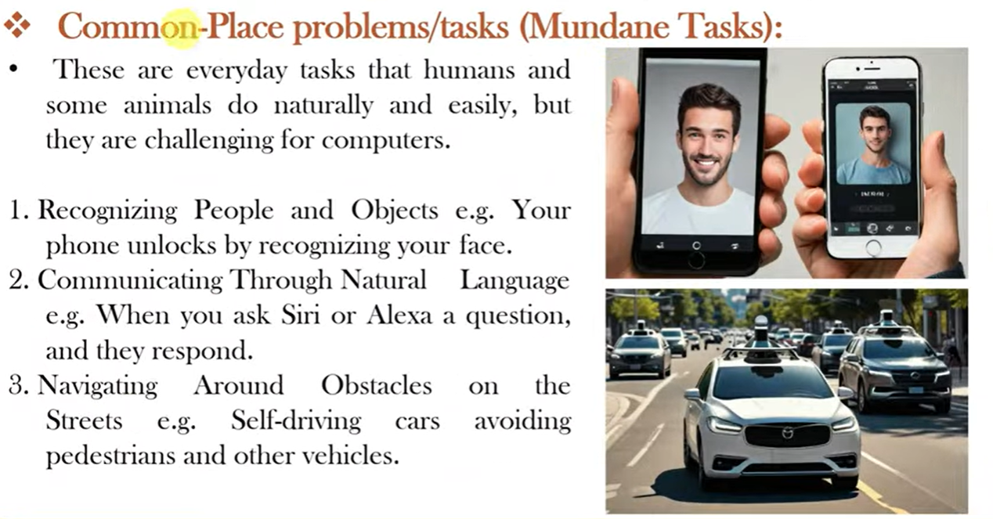

Slide 58
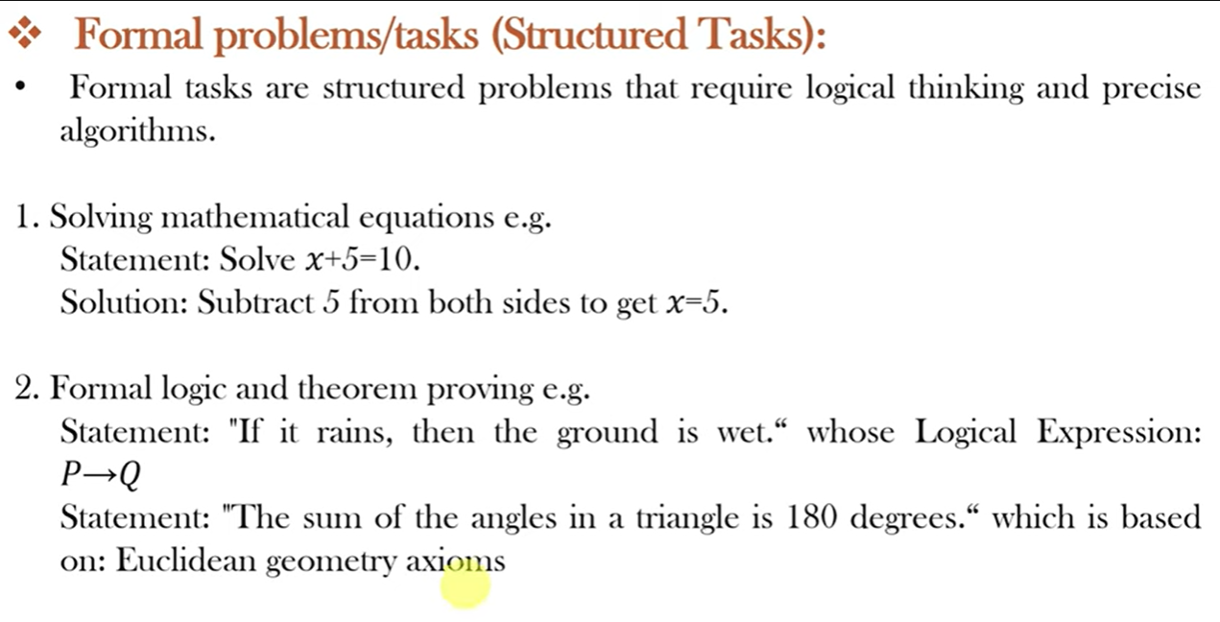

Slide 59
Formal Tasks
Game Playing
Mathematics/ Mathematical problem solving
Logic
Syllogism

Slide 60
Expert tasks:
These tasks cannot be done by all people, and can only be performed by skilled specialists.
Clearly tasks of the first type are easy for humans to perform, and almost all are able to master them.
The second range of tasks requires skill development and/or intelligence and only some specialists can perform them well.
However, when we look at what computer systems have been able to achieve to date, we see that their achievements include performing sophisticated tasks like medical diagnosis, performing symbolic integration, proving theorems and playing chess.

Slide 61
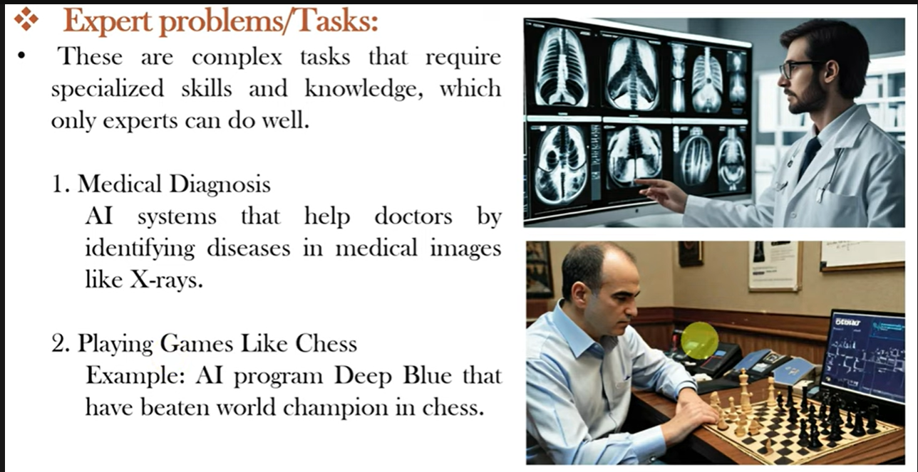

Slide 62
Expert Tasks include
Engineering applications
Scientific analysis
Medical Analysis
Financial Analysis

Slide 63


Slide 64
Outline
Agent
Agents and environments
Rationality
PEAS (Performance measure, Environment, Actuators, Sensors)
Environment types
Agent types

Slide 65
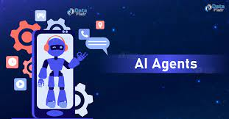

Slide 66
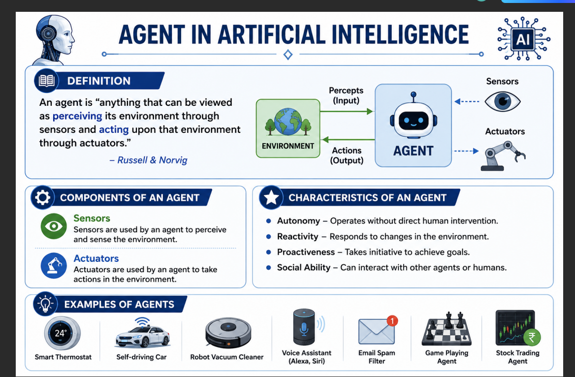

Slide 67
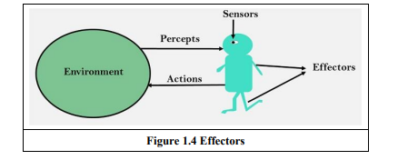
Basic Architecture of Agent

Slide 68
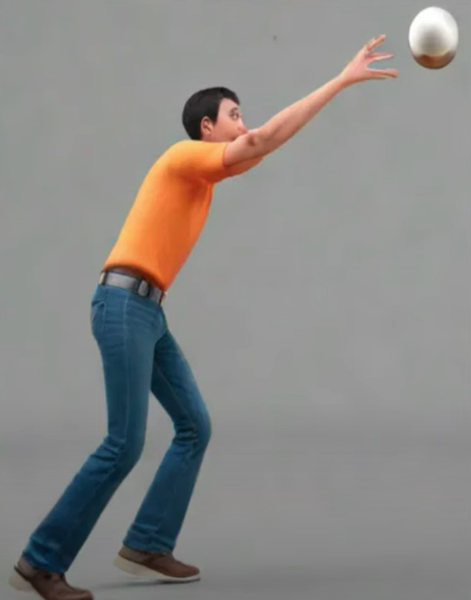

Slide 69
An agent is anything that can be viewed as perceiving its environment through sensors and acting upon that environment through actuators.
  Human Sensors:
    Eyes, ears, and other organs for sensors.
  Human Actuators:
    Hands, legs, mouth, and other body parts.
  Robotic Sensors:
  Mic, cameras and infrared range finders for sensors
  Robotic Actuators:
    Motors, Display, speakers etc…

Slide 70
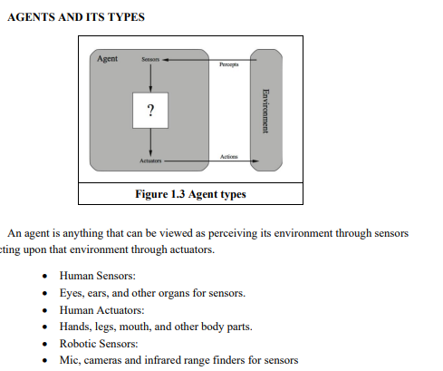
Agents :Introduction

Slide 71
An agent can be:
  Human-Agent: A human agent has eyes, ears, and other organs which work for sensors
  and hand, legs, vocal tract work for actuators.
  Robotic Agent: A robotic agent can have cameras, infrared range finder, NLP for
  sensors and various motors for actuators.
  Software Agent: Software agent can have keystrokes, file contents as sensory input and act on those inputs and display output on the screen.

Slide 72
Further
Hence the world around us is full of agents such as thermostat, cell phone, camera, and even we are also agents. Before moving forward, following terms are important:
Sensor: Sensor is a device which detects the change in the environment and sends the
information to other electronic devices.
An agent observes its environment through sensors.

Slide 73
Actuators: Actuators are the component of machines that converts energy into motion.
The actuators are only responsible for moving and controlling a system. An actuator can be an electric motor, gears, rails, etc.
Effectors: Effectors are the devices which affect the environment.
Effectors can be legs, wheels, arms, fingers, wings, fins, and display screen.

Slide 74
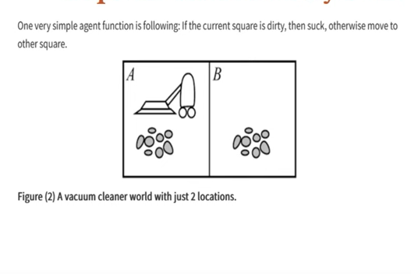

Slide 75
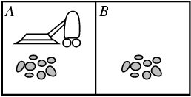
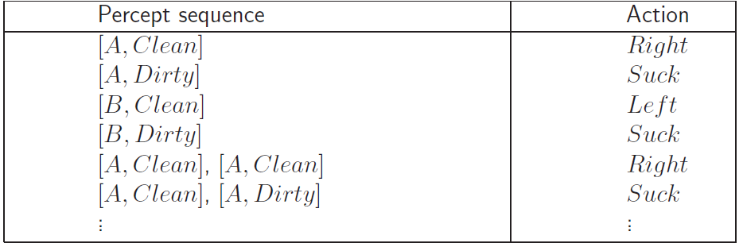
Vacuum-cleaner world
Demo: http://www.ai.sri.com/~oreilly/aima3ejava/aima3ejavademos.html
Percepts: location and contents, e.g., [A,Dirty]
Actions: Left, Right, Suck, NoOp
Agent’s function → look-up table
  For many agents this is a very large table
Notes:
Only 2 locations

Slide 76
PEAS: Descriptor
Performance Measure, Environment, Actuators, Sensors
Performance :The output which get from the agent.
All the necessary results that an agent gives after processing comes under its performance.
Environment: All the surrounding things and conditions of an agent fall in this section. It basically consists of all the things under which the agents work.
Actuators :The devices, hardware or software through which the agent performs any actions or processes any information to produce a result are the actuators of the agent.
Sensors: The devices through which the agent observes and perceives its environment are the sensors of the agent

Slide 77
PEAS
Example 1: The task of designing an automated taxi driver.
Examle 2: Agent: Part-picking robot

Slide 78
Automated taxi driver:
  Performance measure: Safe, fast, legal, comfortable trip, maximize profits
  Environment: Roads, other traffic, pedestrians, customers
  Actuators: Steering wheel, accelerator, brake, signal, horn
  Sensors: Cameras, sonar, speedometer, GPS, odometer, engine sensors, keyboard

Slide 79
PEAS
Agent: Part-picking robot
Performance measure: Percentage of parts in correct bins
Environment: Conveyor belt with parts, bins
Actuators: Jointed arm and hand
Sensors: Camera, joint angle sensors

Slide 80
Environment(as per AI Terminology)
An environment can be described as a situation in which an agent is present/or will perform…
The environment is where agent lives, operate and provide the agent with something to sense and act upon it.

Slide 81
Properties of Environment
1) Fully observable 2) Partially Observable
3) Static 4) Dynamic
5) Discrete 6)Continuous
7) Deterministic 8) Stochastic
9) Single-agent 10) Multi-agent
11) Episodic 12) Sequential
13) Known 14) Unknown

Slide 82
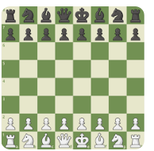
1.Fully observable vs Partially Observable:
  If an agent sensor can sense or access the complete state of an environment at each point of time then it is a fully observable environment, else it is partially observable.
  A fully observable environment is easy as there is no need to maintain the internal state to keep track history of the world.
  Enables better decisions..
  Partially observable is incomplete..
  Note :An agent with no sensors in all environments then such an environment is called as unobservable.
Example: chess – the board is fully observable
For Partially ???

Slide 83
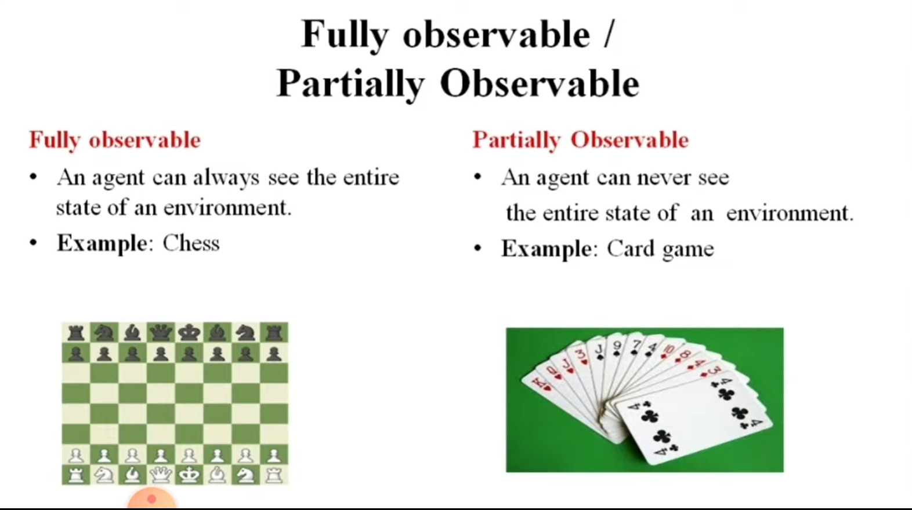
Environment

Slide 84
Examples :
Real-life Example: While running a car on the road ( Environment ), The driver ( Agent ) is able to see road conditions, signboard and pedestrians on the road at a given time and drive accordingly. So Road is a fully observable environment for a driver while driving the car.
Real-life Example: Playing card games is a perfect example of a partially-observable environment where a player is not aware of the card in the opponent’s hand. Why partially-observable? Because the other parts of the environment, e.g opponent, game name, etc are known for the player (Agent).

Slide 85
2. Deterministic vs Stochastic
If an agent's current state and selected action can completely determine the next state of the environment, then such environment is called a deterministic environment.
A stochastic environment is random in nature and cannot be determined completely by an agent.
In a deterministic, fully observable environment, agent does not need to worry about uncertainty
Example: Cross world Puzzle
Taxi driving(stochastic)

Slide 86
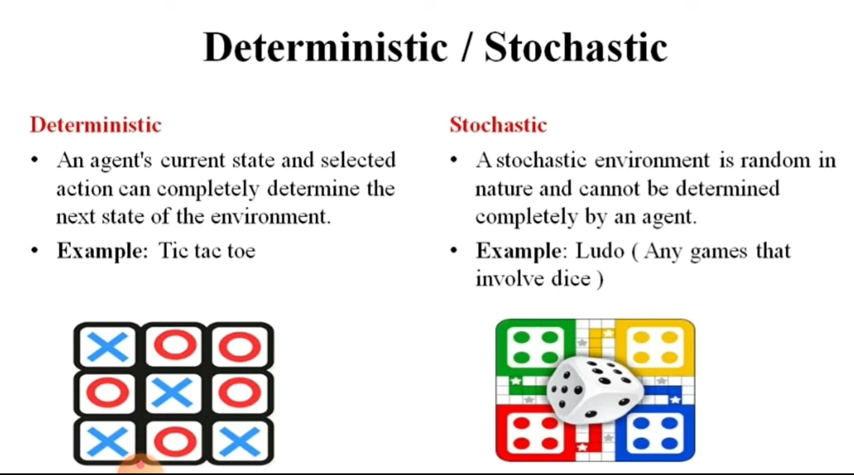
Environment

Slide 87
Examples :
Real-life Example: The traffic signal is a deterministic environment where the next signal is known for a pedestrian (Agent)
Real-life Example: The radio station is a stochastic environment where the listener is not aware about the next song or playing a soccer is stochastic environment

Slide 88
3.Episodic vs Sequential
• In an episodic environment, there is a series of one-shot actions, and only the current percept is required for the action.
In this agent’s experience is divided into atomic episodes which are independent ….
• However, in Sequential environment, an agent requires memory of past actions to determine the next best actions.

Slide 89
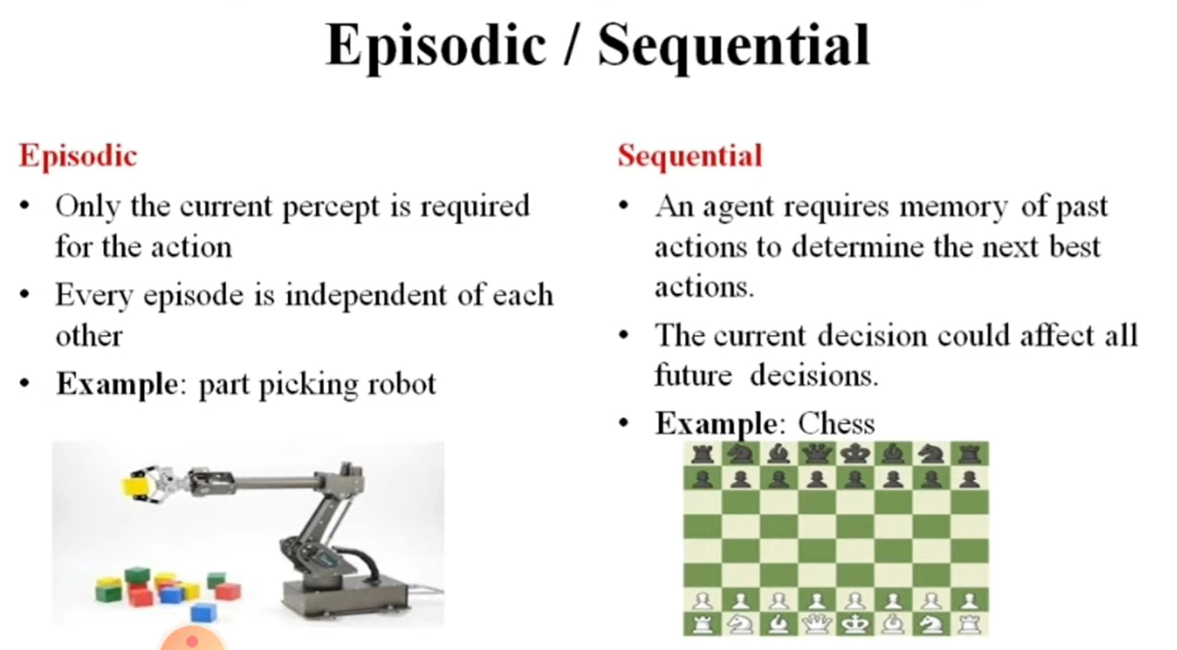
Environment

Slide 90
But some times ,its not possible to achieve exactly the same
Episodic is an environment where each state is independent of each other. The action on a state has nothing to do with the next state.
Real-life Example: A support bot (agent) answer to a question and then answer to another question and so on. So each question-answer is a single episode.
The sequential environment is an environment where the next state is dependent on the current action. So agent current action can change all of the future states of the environment.
Real-life Example: Playing tennis is a perfect example where a player observes the opponent’s shot and takes action.

Slide 91
4. Static vs Dynamic
If the environment can change itself while an agent is deliberating then such environment is called a dynamic environment else it is called a static environment.
Static environments are easy to deal because an agent does not need to continue looking at the world while deciding for an action.
However for dynamic environment, agents need to keep looking at the world at each action.
Taxi driving is an example of a dynamic environment whereas Crossword puzzles are an example of a static environment.

Slide 92
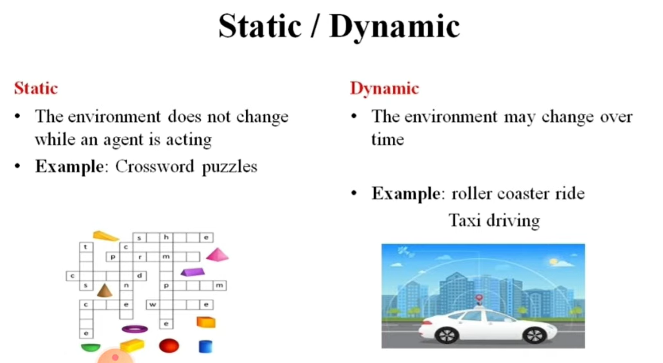
Environment

Slide 93
Examples :
The Static environment is completely unchanged while an agent is precepting the environment.
Real-life Example: Cleaning a room (Environment) by a dry-cleaner reboot (Agent ) is an example of a static environment where the room is static while cleaning.
Dynamic Environment could be changed while an agent is precepting the environment. So agents keep looking at the environment while taking action.
Real-life Example: Playing soccer is a dynamic environment where players’ positions keep changing throughout the game. So a player hit the ball by observing the opposite team.

Slide 94
5. Discrete vs Continuous
If in an environment there are a finite number of precepts and actions that can be performed within it, then such an environment is called a discrete environment else it is called continuous environment.
Continuous environment sweeps through a range of values..
A chess game comes under discrete environment as there is a finite number of moves that can be performed.
A self-driving car is an example of a continuous environment.

Slide 95
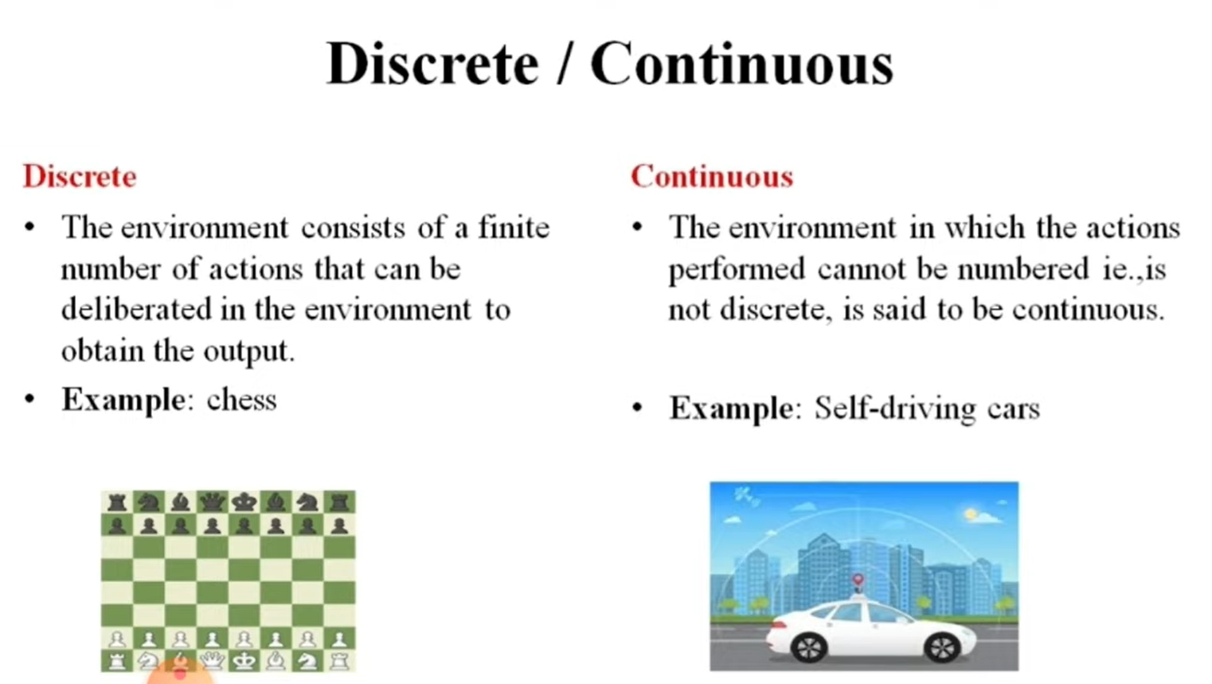
Environment

Slide 96
Examples :
Real-life Example: Choices of a move (action) in a tic-tac game are finite on a finite number of boxes on the board (Environment).
Real-life Example: In a basketball game, the position of players (Environment) keeps changing continuously and hitting (Action) the ball towards the basket can have different angles and speed so infinite possibilities.

Slide 97
6. Single-agent vs Multi-agent
If only one agent is involved in an environment, and operating by itself then such an environment is called single agent environment.
However, if multiple agents are operating in an environment, then such an environment is called a multi-agent environment.
The agent design problems in the multi-agent environment are different from single agent environment
Example : Cross word puzzle..
And for Multi agent???

Slide 98
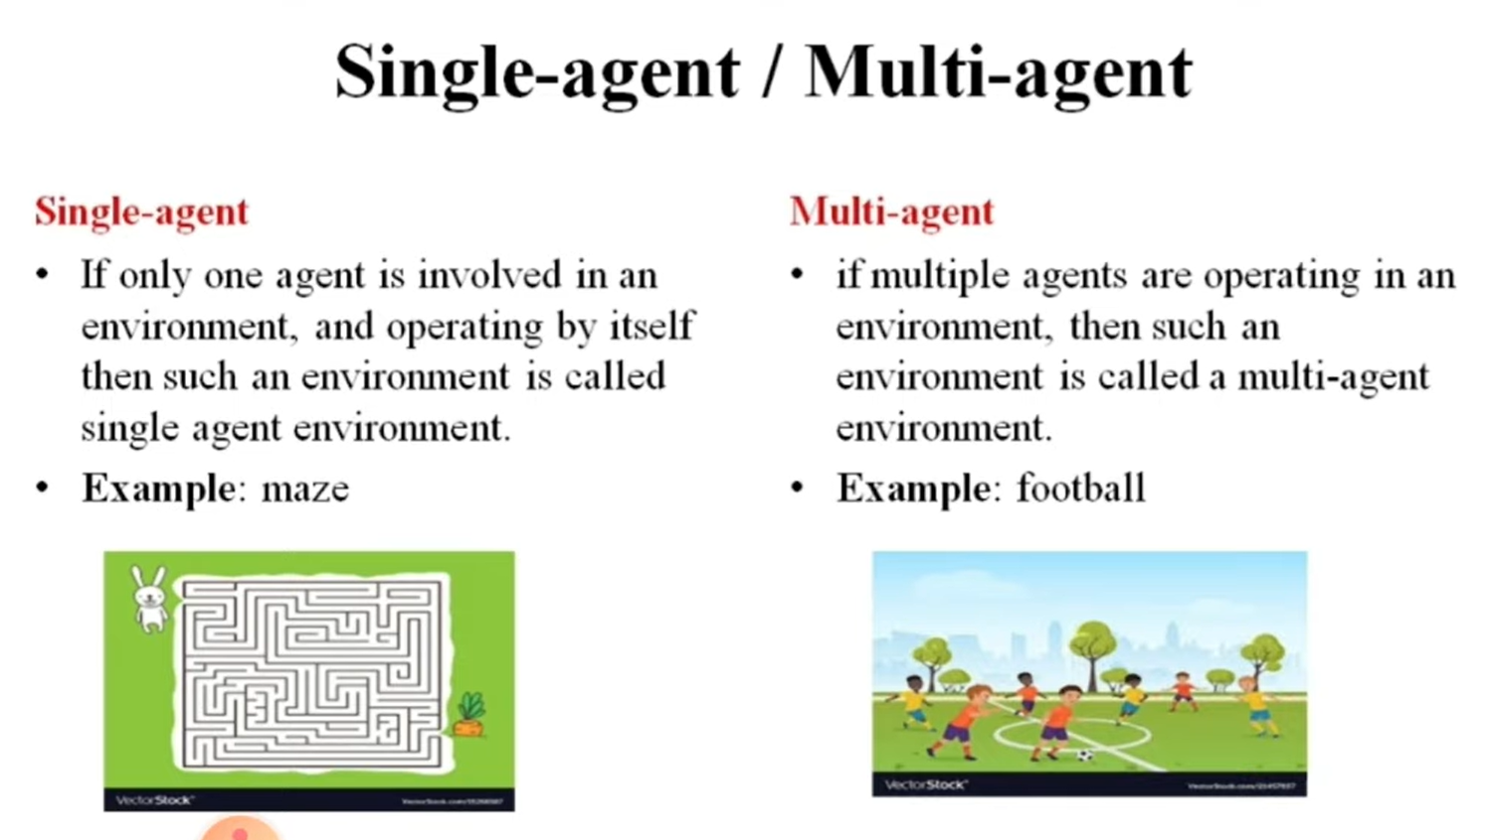
Environment

Slide 99
Examples:
Real-life Example: Playing tennis against the ball is a single agent environment where there is only one player.
Real-life Example: Playing a soccer match is a multi-agent environment.

Slide 100
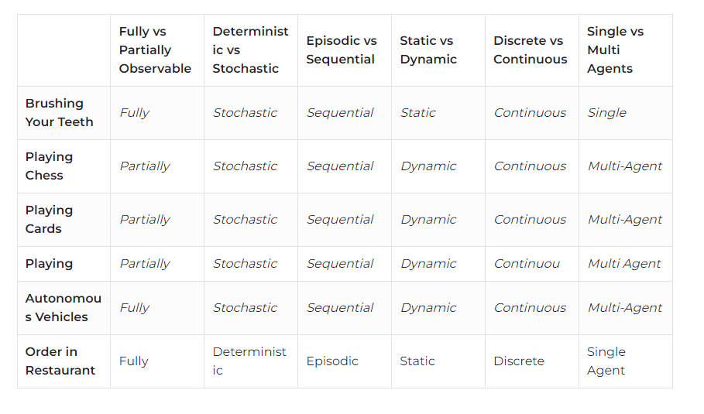
Few of the examples

Slide 101
Types of Agent

Slide 102
Basic Architecture of Agent

Slide 103
Structure of an AI Agent
The task of AI is to design an agent program which implements the agent function
Agent is a combination of architecture and agent program
Agent = Architecture + Agent program
Architecture: Architecture is machinery that an AI agent executes on.
Agent Function: Agent function is used to map a percept to an action.
f:P* → A
Agent program: Agent program is an implementation of agent function. An agent program executes on the physical architecture to produce function (f).

Slide 104
Rational Agent -
A system is rational if it does the “right thing”. Given what it knows.
Characteristic of Rational Agent :
  The agent's prior knowledge of the environment.
  The performance measure that defines the criterion of success.
  The actions that the agent can perform.
  The agent's percept sequence to date.
  For every possible percept sequence, a rational agent should select an action that is expected to maximize its performance measure, given the evidence provided by the percept sequence and whatever built-in knowledge the agent has.

Slide 105
Rationality
Rationality is nothing but status of being reasonable, sensible, and having good sense of judgment.
Rationality is concerned with expected actions and results depending upon what the agent has perceived.
Performing actions with the aim of obtaining useful information is an important part of rationality.
A rational agent always performs right action, where the right action means the action that causes the agent to be most successful in the given percept sequence

Slide 106
TYPES OF AGENTS
Agents can be grouped into four classes based on their degree of perceived intelligence and capability :
• Simple Reflex Agents
• Model-Based Reflex Agents
• Goal-Based Agents
• Utility-Based Agents
• Learning Agent

Slide 107


Slide 108
The Simple reflex agents
The Simple reflex agents are the simplest agents. These agents take decisions on the basis of the current percepts and ignore the rest of the percept history (past State).
These agents only succeed in the fully observable environment.
The Simple reflex agent does not consider any part of percepts history during their decision and action process.
The Simple reflex agent works on Condition-action rule, which means it maps the current state to action.
Such as a Room Cleaner agent, it works only if there is dirt in the room.
Mostly too big to generate and to store.
Not adaptive to changes in the environment.
Condition-Action Rule − It is a rule that maps a state (condition) to an action. Ex: if car-in-front-is-braking then initiate- braking.

Slide 109


Slide 110


Slide 111
Problems for the simple reflex agent design approach:
They have very limited intelligence
They do not have knowledge of non-perceptual parts of the current state

Slide 112


Slide 113
Model Based Reflex Agents
The Model-based agent can work in a partially observable environment, and track the situation.
A model-based agent has two important factors:
Model: It is knowledge about "how things happen in the world," so it is called a Model-based agent.
Internal State: It is a representation of the current state based on percept history.
These agents have the model, "which is knowledge of the world" and based on the model they perform actions.
Updating the agent state requires information about:
  How the world evolves
  How the agent's action affects the world.

Slide 114


Slide 115
Goal Based Agents
The knowledge of the current state environment is not always sufficient to decide for an agent to what to do.
The agent needs to know its goal which describes desirable situations.
Goal-based agents expand the capabilities of the model-based agent by having the "goal" information.
They choose an action, so that they can achieve the goal.
These agents may have to consider a long sequence of possible actions before deciding whether the goal is achieved or not.
Such considerations of different scenario are called searching and planning, which makes an agent proactive.

Slide 116


Slide 117
Utility Based Agents
These agents are similar to the goal-based agent but provide an extra component of utility measurement (“Level of Happiness”) which makes them different by providing a measure of success at a given state.
Utility-based agent act based not only goals but also the best way to achieve the goal.
The Utility-based agent is useful when there are multiple possible alternatives, and an agent has to choose in order to perform the best action.
The utility function maps each state to a real number to check how efficiently each action achieves the goals.

Slide 118


Slide 119
Learning Agents
A learning agent in AI is the type of agent which can learn from its past experiences, or it has learning capabilities.
It starts to act with basic knowledge and then able to act and adapt automatically through learning.
A learning agent has mainly four conceptual components, which are:
Learning element: It is responsible for making improvements by learning from environment
Critic: Learning element takes feedback from critic which describes that how well the agent is doing with respect to a fixed performance standard. c. Performance element: It is responsible for selecting external action
Problem generator: This component is responsible for suggesting actions that will lead to new and informative experiences.
Hence, learning agents are able to learn, analyze performance, and look for new ways to improve the performance.

Slide 120
Building goal-based agents
To build a goal-based agent we need to answer the following questions:
  What is the goal to be achieved?
  What are the actions?
  What is the representation?
    E.g., what relevant information is necessary to encode in order to describe the state of the world, describe the available transitions, and solve the problem?)
Initial
state
Actions
Goal
state

Slide 121
PROBLEM SOLVING APPROACH TO TYPICAL AI PROBLEMS
Problem formulation: is a special kind of goal based agent
PSA decides what to do
Find sequence of actions to solve it

Slide 122
PSA has the following 3 key words:
1.FORMULATE
2.SEARCH
3.EXECUTE

Slide 123
PROBLEM FORMULATION IS DESCRIBED BY :
INITIAL STATE
SUCCESSOR FUNCTION
STATE SPACE
PATH SPACE
GOAL TEST
PATH COST
STEP COST

Slide 124
GOAL FORMULATION HAS THE FOLLOWING
GOAL COSTS:
The costs of the final path selected
PATH COSTS:
The cost given to each path

Slide 125
Evaluation criteria:
    completeness: will it find a solution if one exists?
    time efficiency:
    space efficiency:
    optimality of solution:

Slide 126
Example Problems of PSA:
  Toy problems:
    8-puzzle
    8-queen/n-queen
    cryptarithmetic
    vacuum world
    missionaries and cannibals
  Real World
    Traveling Salesperson (NP hard)
    VLSI layout
    robot navigation
    assembly sequencing

Slide 127

Vacuum cleaner:
States: 8
Initial state: any idle state
Successor function:
left,right suck,idle
Goal Test: clean the surface
Path Cost: each step:1 (step may be towards left/right/suck)

Slide 128
States: 8
Initial state: any idle state
Successor function:
left,right suck,idle
Goal Test: clean the surface
Path Cost: each step:1 (step may be towards left/right/suck)

Slide 129

8-PUZZLE
States:
Initial state:
Successor function:
Goal Test:
Path Cost:

Slide 130
States: 9!(3x3)(rows/columns)
Initial state: any idle state
Successor function:
left,right up,down
Goal Test: sequence from 1-8(in order)
Path Cost: each step:1

Slide 131


Slide 132

8-Queen Problem
Initial States: any arrangement of 0 to 8 queens on the board.
Operators: place a queen in the left-most empty column such that it is not attacked by any other queen.
The objective is to place eight queens on a chessboard such that no queen threatens another.
A queen threatens another queen in the same row, column or diagonal.
2057 possible sequences to investigate.

Slide 133
Representing states
What information is necessary to encode about the world to sufficiently describe all relevant aspects to solving the goal?
That is, what knowledge needs to be represented in a state description to adequately describe the current state or situation of the world?
The size of a problem is usually described in terms of the number of states that are possible.
  The 8-puzzle has 181,440 states.
  Tic-Tac-Toe has about 3⁹ states.
  Rubik’s Cube has about 10¹⁹ states.
  Checkers has about 10⁴⁰ states.
  Chess has about 10¹²⁰ states in a typical game.

Slide 134
Missionaries and Cannibals
Three missionaries and three cannibals wish to cross the river. They have a small boat that will carry up to two people. Everyone can navigate the boat. If at any time the Cannibals outnumber the Missionaries on either bank of the river, they will eat the Missionaries. Find the smallest number of crossings that will allow everyone to cross the river safely.

Slide 135


Slide 136
Missionaries and Cannibals
Goal: Move all the missionaries and cannibals across the river.
Constraint: Missionaries can never be outnumbered by cannibals on either side of river, or else the missionaries are killed.
State: configuration of missionaries and cannibals and boat on each side of river.
Initial State: 3 missionaries, 3 cannibals and the boat are on the near bank
Operators: Move boat containing some set of occupants across the river (in either direction) to the other side.

Slide 137
Missionaries and Cannibals Solution
Near side Far side
0 Initial setup: MMMCCC B -
1 Two cannibals cross over: MMMC B CC
2 One comes back: MMMCC B C
3 Two cannibals go over again: MMM B CCC
4 One comes back: MMMC B CC
5 Two missionaries cross: MC B MMCC
6 A missionary & cannibal return: MMCC B MC
7 Two missionaries cross again: CC B MMMC
8 A cannibal returns: CCC B MMM
9 Two cannibals cross: C B MMMCC
10 One returns: CC B MMMC
11 And brings over the third: - B MMMCCC

Slide 138
Cryptarithmetic
Find an assignment of digits (0, ..., 9) to letters so that a given arithmetic expression is true.
examples: SEND + MORE = MONEY and
    FORTY Solution: 29786
    + TEN 850
    + TEN 850
    ----- -----
    SIXTY 31486
    F=2, O=9, R=7, etc.

Slide 139
Cryptarithmetic
State: mapping from letters to digits
Initial State: empty mapping
Operators: assign a digit to a letter
Goal Test: whether the expression is true given the complete mapping
Note: In this problem, the solution is NOT a sequence of actions that transforms the initial state into the goal state; rather, the solution is a goal node that includes an assignment of a digit to each letter in the given problem.
Find an assignment of digits to letters so that a given arithmetic expression is true. examples: SEND + MORE = MONEY and
    FORTY Solution: 29786
    + TEN 850
    + TEN 850
    ----- -----
    SIXTY 31486
    F=2, O=9, R=7, etc.

Slide 140
Water Jug Problem
Given a full 5-gallon jug and a full 2-gallon jug, fill the 2-gallon jug with exactly one gallon of water.
State: ?
Initial State: ?
Operators: ?
Goal State: ?
5
2

Slide 141
Water Jug Problem
Operator table
State = (x,y), where x is the number of gallons of water in the 5-gallon jug and y is # of gallons in the 2-gallon jug
Initial State = (5,2)
Goal State = (*,1), where * means any amount
Name | Cond. | Transition | Effect
Empty5 | – | (x,y)→(0,y) | Empty 5-gal. jug
Empty2 | – | (x,y)→(x,0) | Empty 2-gal. jug
2to5 | x ≤ 3 | (x,2)→(x+2,0) | Pour 2-gal. into 5-gal.
5to2 | x ≥ 2 | (x,0)→(x-2,2) | Pour 5-gal. into 2-gal.
5to2part | y < 2 | (1,y)→(0,y+1) | Pour partial 5-gal. into 2-gal.
5
2

